Slide 1
Booking System
Prepared by
B10815044 Hsieh, Jun-Yao
B10815054 Huang, Chen-En
B10815058 Pu, Chi-Hao
B10815057 Liao, Sheng-Hao
Group 8

Slide 2
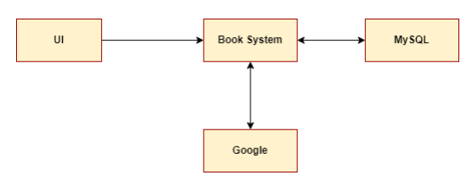
Team Members
Hsieh, Jun-Yao (Project Manager) (Developer) | Meeting Host Documents Management Develop and Manage Database Help to develop the main system System Test Job assignment and coordinate
Huang, Chen-En (Developer) | Google Calendar API interface Functional requirement implement Technical writer
Pu, Chi-Hao (UI Design) (Developer) | GUI design Technical writer System tester
Liao, Sheng-Hao (Program Manager) (Developer) | Core component design Core component implement Run & Build manual writer Google account provider Technical writer System tester

Slide 3
Features
Booking
Choose room
Choose date & time
Create meeting
Modify meeting
Delete meeting
My meeting
Manage room (Admin only)
Add room
Edit room
Delete room

Slide 4
Limitation
The participant not allow two meeting at same time
The room not allow two meeting at same time

Slide 5
Functional requirements (1/2)
Create meeting room：Create a meeting room in database
Create Meeting：create a upcoming meeting in the meeting room
Update Meeting Title：modify the title of the meeting that already existed in meeting room
Update Meeting Description：modify the description of the meeting that already existed in meeting room
Update Meeting Time：modify the time of the meeting that already existed in meeting room

Slide 6
Functional requirements (2/2)
Add Attendee：Add participant into the meeting that already existed in meeting room
Remove Attendee：Remove the participant from the meeting that already existed in meeting room
Delete Meeting：Remove the meeting that already existed in meeting room
Delete Meeting Room：Delete the Meeting Room
Update meeting room name：modify the name of the meeting room that already existed

Slide 7
Non-Functional requirement
Performance requirement
Use load balance to handle if too many users access the database at the same time.
Safety requirement
Backup database to prevent users from doing irreversible or illegal operations.
Security requirement
Verify the user’s identity before user access to database.

